Slide 1
Credit One Loan Default Attenuation Proposal
Caitlin Kuecher
Class 5 Task 1

Slide 2
Objective
Recently there has been an increase in defaulting loan customers, putting Credit One at risk of losing business. Our goal is to better identify potential defaulting loan customers using robust data analysis techniques.

Slide 3
Data Science Process Framework
Because predictive analytics are imperfect and do not always deliver results applicable to the business world, we have selected a data science process framework that is designed to be specifically applied to answer business problems.
The Process framework is BADIR, and consists of five steps that keep the important business questions at the forefront.
This process focuses on identifying real business impact rather than simply running predictive models in a vacuum.
BADIR Steps:
Business Question
Analysis Plan
Data Collection
Insights
Recommendations

Slide 4
Data Source
Historical data and variable definitions have been provided by Credit One. The data was collected in Taiwan monthly from April 2005, to September 2005.
The dataset contains 30,000 observations with 24 variables stored as a CSV file.
The variable definitions were provided on a 2-page PDF.

Slide 5
Data Management
Alert! Analytics has designed and developed robust data management protocols to ensure the highest levels of security and privacy for our customers. All data is managed and utilized by a team of data specialists and practitioners, working together to combine the very latest expertise in data standards, storage, access, analysis and visualization.
Data will be read using Python, and stored in a Jupyter notebook.
Data will be cleaned, munged, and used within Python.

Slide 6
Known Issues with the Data
There are no known issues with the data.

Slide 7
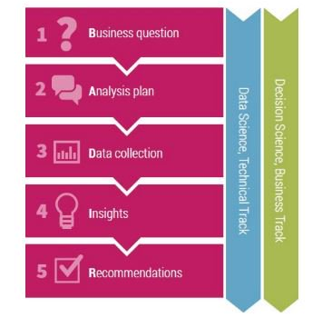
Process Framework
Potential Problems and Solutions
BADIR: Steps from Data to Decisions
Timeframe
If this project is not completed quickly, Credit One will lose or go out of business.
Solution: Reallocate all other tasks to focus solely on this project.
Accuracy
Model may not provide enough accuracy for application
Solution: Run multiple models with various tuning parameters.

Slide 8
Initial Data Insights

Slide 9
Initial Data Insights

Slide 10
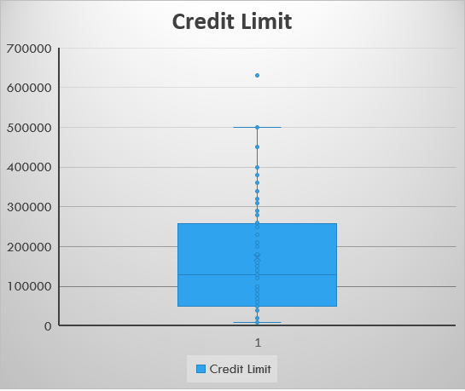
Initial Data Insights

